Slide 1
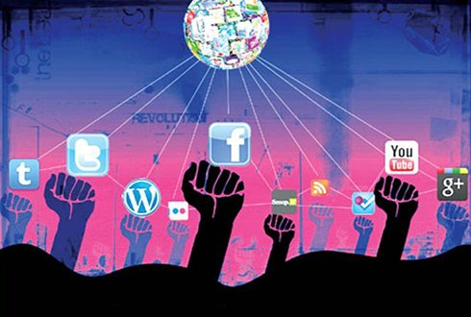
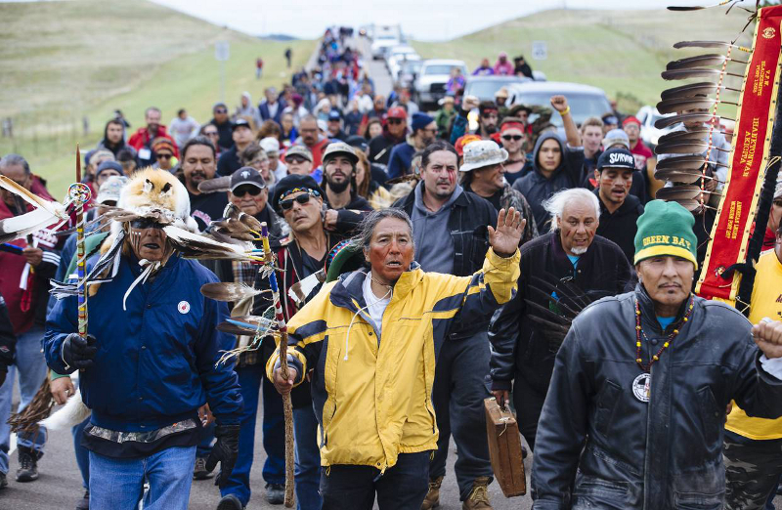
Dell Conversation Class
Christopher bAUMAN

Slide 2
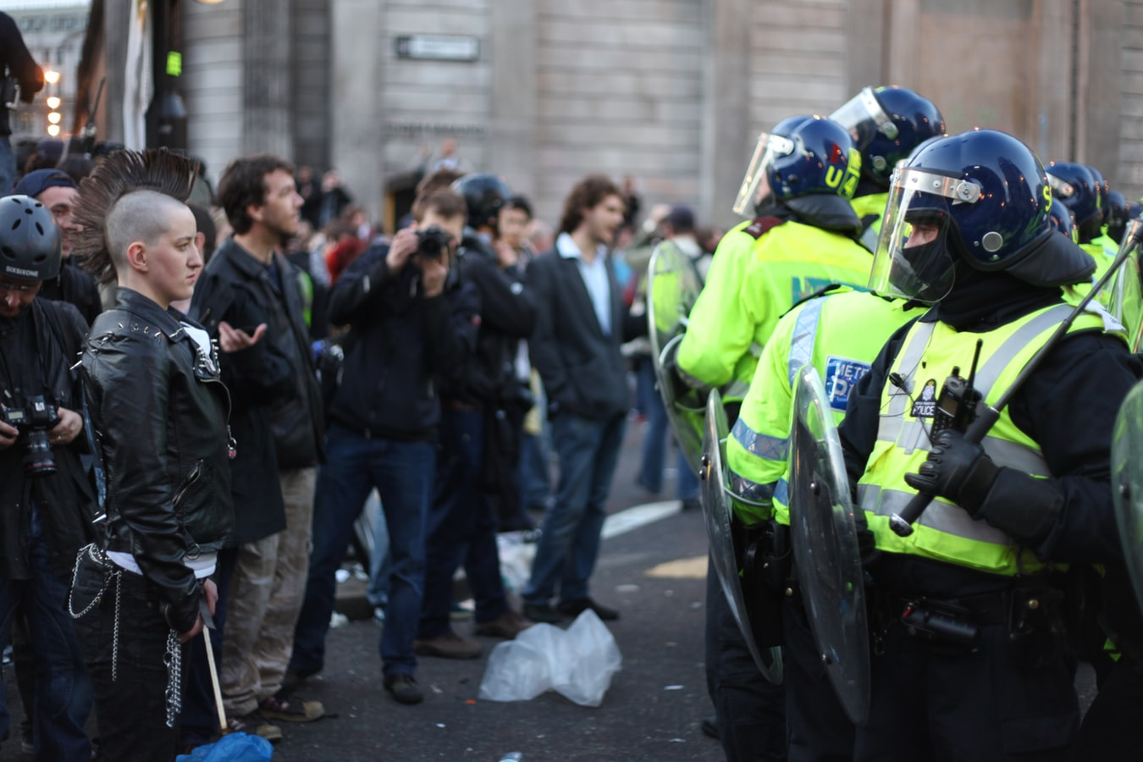
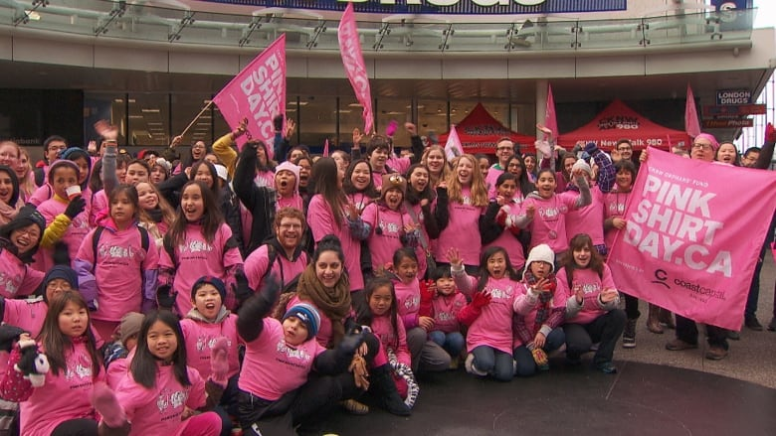
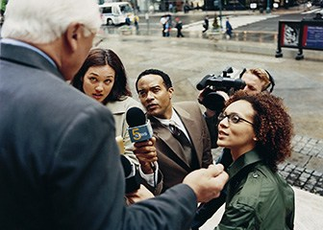
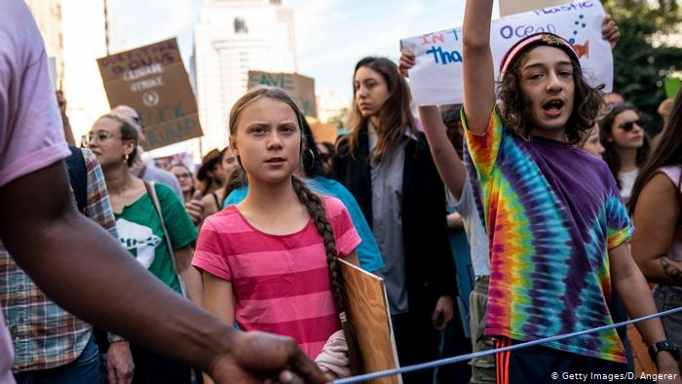
Education Infographic
Front line protestors
Celebrity protestors
Social media promoting change
Minority groups
Strike action
Climate change
Pipeline protests
Plastic straw protests
Sit in protest
Celebrity protests
Viral tweet, image, post
Websites
Influencers
Role of the media
Chris Bauman

